Slide 1
Lecture 11
Stochastic processes: Intro to Brownian motion
Statistical computing: The Gibbs Sampler
Intro to Hierarchical modeling

Slide 2
Example: The Gibbs sampler to generate from a bivariate normal distribution
#initialize values for constants and parameters
N <- 6000 #length of chain
burn <- 1500 #burn-in length
X <- matrix(0, N, 2) #the chain, a bivariate sample
rho <- -.8 #correlation
mu1 <- 0
mu2 <- 2
sigma1 <- 1
sigma2 <- .5
s1 <- sqrt(1-rho^2)*sigma1
s2 <- sqrt(1-rho^2)*sigma2
###### generate the chain #####
X[1, ] <- c(mu1, mu2) #initialize
for (i in 2:N) {
x2 <- X[i-1, 2]
m1 <- mu1 + rho * (x2 - mu2) * sigma1/sigma2
X[i, 1] <- rnorm(1, m1, s1)
x1 <- X[i, 1]
m2 <- mu2 + rho * (x1 - mu1) * sigma2/sigma1
X[i, 2] <- rnorm(1, m2, s2)
}
b <- burn + 1
x <- X[b:N, ]

Slide 3
# compare sample statistics to parameters
colMeans(x)
[1] -0.04791507 2.01863769
cov(x)
[,1] [,2]
[1,] 1.0163774 -0.4149798
[2,] -0.4149798 0.2584467
cor(x)
[,1] [,2]
[1,] 1.000000 -0.809681
[2,] -0.809681 1.000000
plot(x, main="", cex=.5, xlab=bquote(X[1]),
ylab=bquote(X[2]), ylim=range(x[,2]))

Slide 4
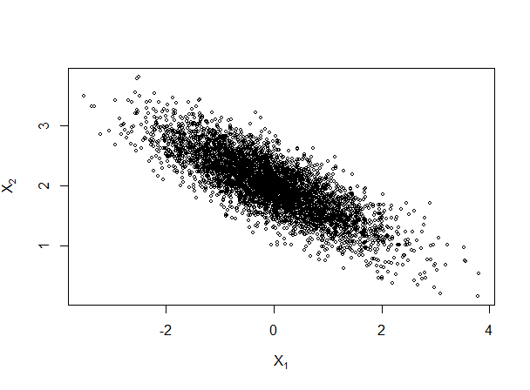

Slide 5
Example: Flipping a random coin
rcoin<-function(p1,m)
{s1<-matrix(0,m,2)
dimnames(s1)[[2]]<-c("p","y")
for(i in 1:m)
{y<-rbinom(1,12,p1)
p1<-rbeta(1,y+4,20-y)
s1[i,]<-c(p1,y)}
s1}

Slide 6
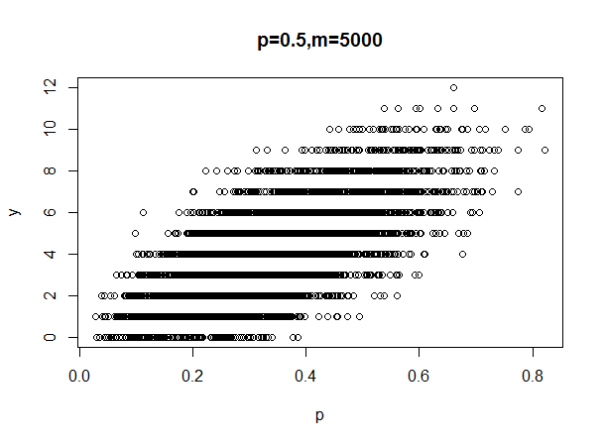
plot(sval1, main="p=0.5,m=5000")

Slide 7
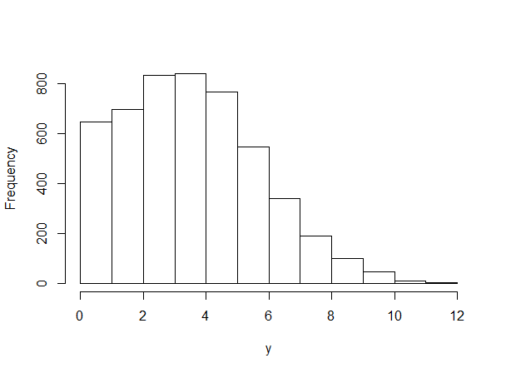

Slide 8
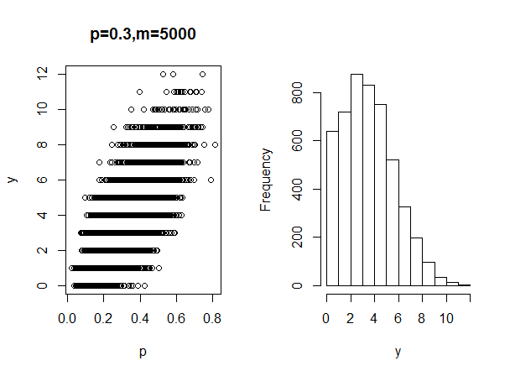

Slide 9
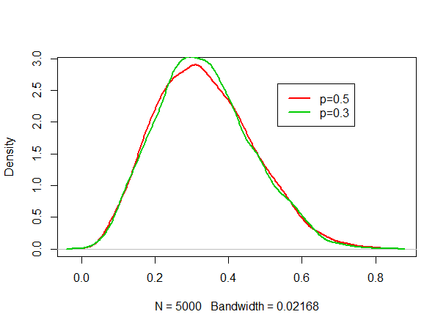

Slide 10
Readings
Yusuf, S., Peto, R., Lewis, J., Collins, R., & Sleight, P. (1985). Beta blockade during and after myocardial infarction: an overview of the randomized trials. Progress in cardiovascular diseases, 27(5), 335-371.
Geman, S., & Geman, D. (1984). Stochastic relaxation, Gibbs distributions, and the Bayesian restoration of images. IEEE Transactions on pattern analysis and machine intelligence, (6), 721-741.

